Slide 1
MIL-PRF-32662: Operationalizing Science through Anticipatory/Translational DOD Performance Requirements
U.S. Army
Robert Jensen
DEVCOM ARL
DEVCOM ARL
A
Robert Jensen, 240-676-9401
18 MAY 2022
Notes:
Version 05.26.2022

Slide 2
MIL-PRF-32662: Adhesive, High-Loading Rate, for Structural and Armor Applications
August 2020
Army capability gaps & commercial opportunity
Leap-ahead performance motivated by Ground Vehicle armor
Translational science
Anticipatory timing
Data science enabled

Slide 3

2 Problems
Army capability gap
  High strength & high damage tolerance adhesives for bonded armor
Pain points
  Understanding & translating high-strain rate and non-linear fracture mechanics into relevant product metrics
  Ambiguous operating environment with rapid evolution pace
Traditional solution
  Peer review academic studies, publications & conference presentations
    Low impact & low commercial relevance
Adhesives industry challenges
  Market penetration with new product
Pain points
  New product qualification for customers is labor intensive and expensive
    Incumbent lock-in
Traditional solution
  Free product samples & PDF technical data sheets
    Relying on customer validation of performance
    Low success rate
Notes:
Redman, T.C., 2016. Bad data costs the US $3 trillion per year. Harvard Business Review, 22, pp.11-18. https://hbr.org/2016/09/bad-data-costs-the-u-s-3-trillion-per-year

Slide 4
2 Problems made for each other
2 intractable problems if viewed independently
Solvable when paired together
Army capability gap
  High strength & high damage tolerance adhesives for bonded armor
Pain points
  Understanding & translating high-strain rate and non-linear fracture mechanics into relevant product metrics
  Ambiguous operating environment with rapid evolution pace
Traditional solution
  Peer review academic studies, publications & conference presentations
    Low impact & low commercial relevance
Adhesives industry challenges
  Market penetration with new product
Pain points
  New product qualification for customers is labor intensive and expensive
    Incumbent lock-in
Traditional solution
  Free product samples & PDF technical data sheets
    Reliant on customer validation
    Low success rate
Notes:
R. Jensen, W. Kosik, J. Gardner, D. O’Brien. “Critical adhesive needs for Army applications and opportunities for innovation,” ARL-RP-323, June 2011
R. Jensen, W. Kosik Chaney, D. DeSchepper, D. Flanagan. “Leveraging Army unique mission requirements to advance the state-of-the-art in adhesives development,” ARL-RP-360, March 2012.

Slide 5
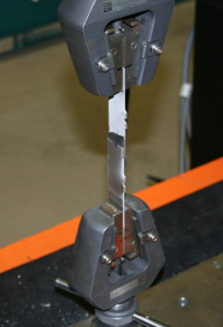
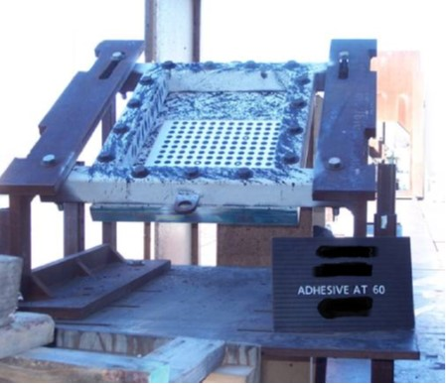
Army capability gaps & commercial opportunity
ceramic strike face
backing plate
projectile
$$$, complex,
commercially irrelevant
adhesive
¢¢¢, “simple”,
commercial benchmark
Notes:
ASTM Standard D1002-10 "Standard Test Method for Apparent Shear Strength of Single-Lap-Joint Adhesively Bonded Metal Specimens by Tension Loading (Metal-to-Metal)." ASTM International, West Conshohocken, PA, 2010, DOI: 10.1520/D1002-10, www.astm.org
Gao et al. Influence of epoxy adhesive layer on impact performance of TiB2-B4C composites armor backed by aluminum plate. International Journal of Impact Engineering 122, 60-72 (2018).
Bogetti et al. Predicting the nonlinear response and failure of composite laminates: Correlation with experimental results. Composites Science and Technology 64, 477-485 (2004).
Bartus. A review: Impact damage of composite materials. Journal of Advanced Materials 39, 3-21 (2007).
Bogetti et al. Predicting the nonlinear response and failure of composite laminates: Correlation with experimental results. Composites Science and Technology 64, 477-485 (2004).
“Collaborative Research Alliance (CRA) for Materials in Extreme Dynamic Environments (MEDE)”, funding opportunity title announced by the U.S. Army Research Laboratory, 2011, http://www.arl.army.mil/www/pages/532/FINAL_MEDE_PA.pdf

Slide 6

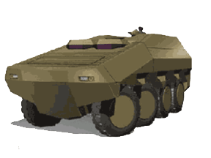
Army capability gaps & commercial opportunity
High strength & very stiff
Variable strength & high damage tolerance
Max strength (MPa)

Slide 7
Army capability gaps & commercial opportunity
Correlation statistics
Max Strength (MPa)
Max strength (MPa)
Max strength (MPa)
Notes:
J. Robinette, J. Gardner, R. Jensen, S. McKnight. “Lap-shear strength versus elongation to failure of candidate composite armor adhesives,” ARL-TR-4862, June 2009.
R. Jensen, W. Kosik Chaney, J. Kaufman, B. Henrie. “Screening adhesively bonded single-lap-joint testing results using nonlinear calculation parameters,” ARL-RP-362, March 2012.
R. Jensen, D. DeSchepper, D. Flanagan. “Multivariate Analysis of High Through-Put Adhesively Bonded Single Lap Joints: Experimental and Workflow Protocols,” ARL-TR-7966, June 2016. http://hdl.handle.net/11256/699
R. Jensen, D. DeSchepper, D. Flanagan “Multivariate analysis of high through-put adhesively bonded single lap joints”, International Journal of Adhesion and Adhesives, 89, 2019, 1-10.

Slide 8
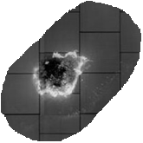
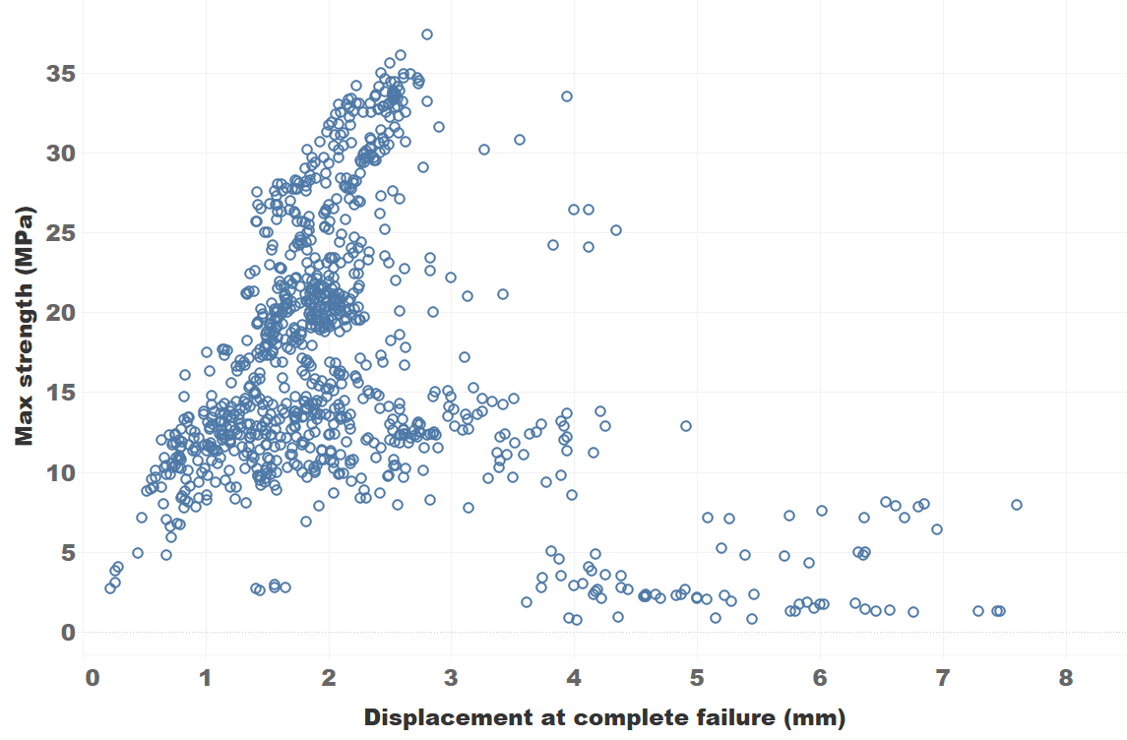

Army capability gaps & commercial opportunity
Poor damage tolerance
High damage tolerance
ceramic strike face
backing plate
Max strength (MPa)
projectile
adhesive
Displacement at complete failure (mm)
Including total joint yielding!!!

Slide 9
Army capability gaps & commercial opportunity
Army capability gap
Max strength (MPa)
Displacement at complete failure (mm)

Slide 10
Army capability gaps & commercial opportunity
Commercial opportunity
Max strength (MPa)
Displacement at complete failure (mm)

Slide 11
Army capability gaps & commercial opportunity
MIL-PRF-32662: Adhesive, High-Loading Rate, for Structural and Armor Applications
Group III
Group II
Group I
Strength ≥ 10.0 MPa
displacement > 3.81 mm
Minimal test burden, optimized for armor
  Single lap joint
    Room temp
    Hot/wet
    Elevated temp
  Mode I stress corrosion cracking
  Pre-2018 all Group I adhesives were experimental and failed environmental conditioning
Max Strength (MPa)
Group IV
Displacement at complete failure (mm)
Notes:
R. Jensen, D. DeSchepper, D. Flanagan, W. Kosik-Chaney, J. Robinette, G. Chaney, C. Pergantis. “Adhesives: test method, groups assignment, and categorization guide for high-loading rate applications,” ARL-ADHES-QA-001.00 rev 1.0, ARL-SR-288, June 2014.
R. Jensen, D. DeSchepper, D. Flanagan, G. Chaney, C. Pergantis. “Adhesives: Test Method, Group Assignment, and Categorization Guide for High-Loading-Rate Applications – Preparation and Testing of Single Lap Joints,” ARL-ADHES-QA-001.01 Rev 2.2, ARL SR-0356, April 2016.
Strategic Environmental Research and Development Program, “Understanding Corrosion Protection Requirements for Adhesive Bond Primers”, SERDP-WP-2144, September 2016.
R. Jensen, D. Flanagan, D. DeSchepper, C. Pergantis. “Adhesives: Test Method, Group Assignment, and Categorization Guide for High-Loading-Rate Applications – History and Rationale,” ARL-ADHES-QA-001.01 Rev 2.2, ARL SR-0371, April 2017.
R. Jensen, D. Flanagan, D. DeSchepper, M. Silton. “Single-Lap-Joint Screening of Hysol EA 9309NA Epoxy Adhesive,” ARL-TR-8011, May 2017. http://hdl.handle.net/11256/939
MIL-STD-3059 (MR). Acceptance criteria for adhesives for high-loading rate applications, Department of Defense Test Method Standard, 22 November 2018.
MIL-PRF-32662, Performance Specification, “Adhesive, High-Loading Rate, for Structural and Armor Applications”, 13 August 2020.
B. Rindespacher, B. Placzankis, W. Lum, R. Jensen. “MIL-PRF-32662: Adhesive, High-Loading Rate, for Structural and Armor Applications— Frequently Asked Questions”, ARL-TN-1035, September 2020.

Slide 12

Leap-ahead performance motivated by Ground Vehicle armor
PPG PR-2930
  Toughened epoxy
  Passed environmental tests
  Commercially scaled
Max Strength (MPa)
Group I
Displacement at complete failure (mm)
Notes:
PPG Development of PR-2930: Research was sponsored by the Army Research Laboratory and was accomplished under Cooperative Agreement Number W911NF-13-2-0046 to Drexel University and Sub-agreement to PPG Industries, Inc. The views and conclusions contained in this document are those of the authors and should not be interpreted as representing the official policies, either expressed or implied, of the Army Research Laboratory or the U.S. Government. The U.S. Government is authorized to reproduce and distribute reprints for Government purposes notwithstanding and copyright notification herein.

Slide 13

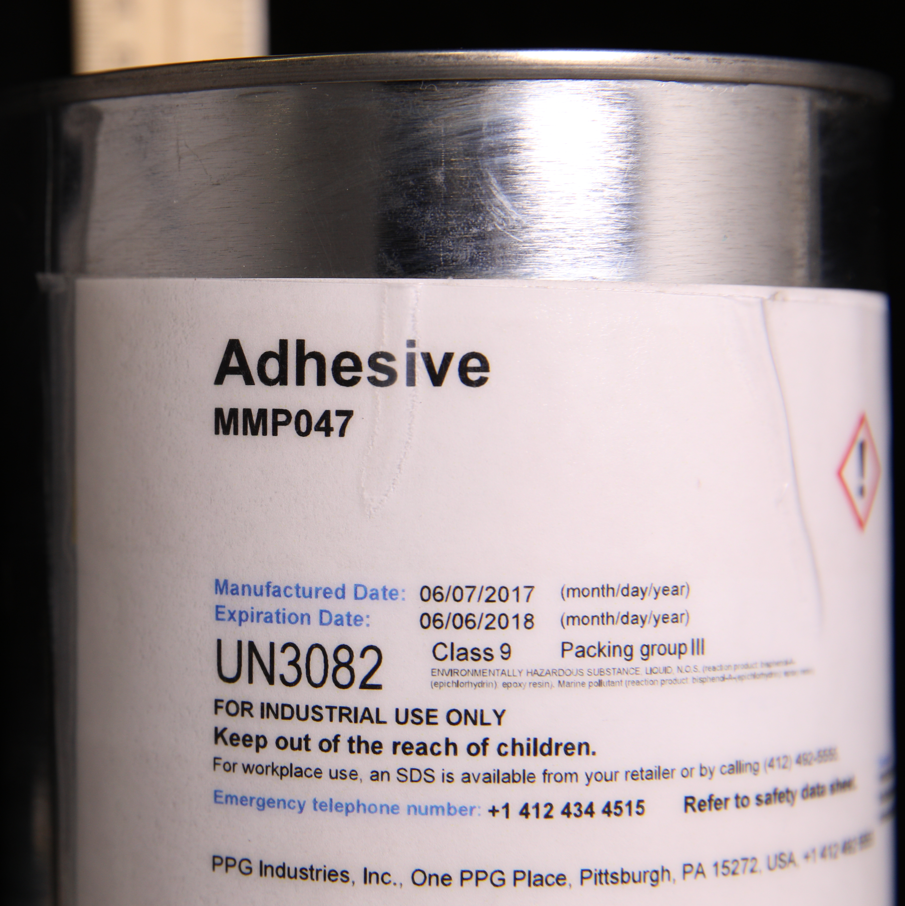
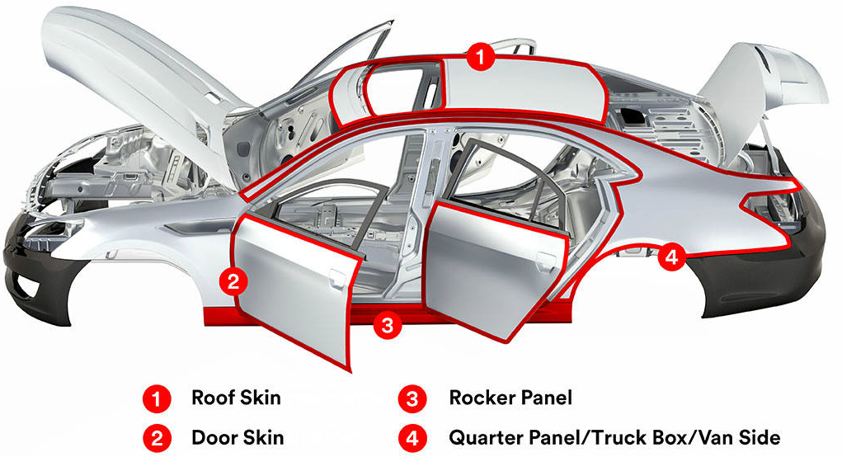
Leap-ahead performance motivated by Ground Vehicle armor
Outcomes
TRL1 to MRL9 in 4 years
Independent validation of MIL-PRF-32662’s data-driven ballistic to static correlations
1st place 2020 industry innovation award
Available for DoD trials as obtainable commercial product
MIL-PRF-32662
Embedded drivers for armor bonding
3m.com
15% of $1.5B/year vehicle assembly market*
Growth rate at 4X GDP
* “Breakthrough to a World Challenge, BETAMATE Structural Adhesives", Dow Automotive Systems
Notes:
https://www.ascouncil.org/page/Innovation_Awards#:~:text=The%20ASC%20Innovation%20Awards%20Program,needs%20and%20advancements%20in%20technology.

Slide 14
Leap-ahead performance motivated by Ground Vehicle armor
PPG PR-2930
  Toughened epoxy
  Mode I Fracture Energy (G_{IC}) 3,200 +/- 450 J/m²
  Aerospace 1,000 – 2500 J/m²
Max Strength (MPa)
Group I
Displacement at complete failure (mm)
Notes:
F. Palmieri et al “Optimized surface treatment of aerospace composites using a picosecond laser”, Composites Part B, 175, 2019, 107155.

Slide 15
Leap-ahead performance motivated by Ground Vehicle armor
Validated ballistic tolerance
Max Strength (MPa)
Group I
Bondline survived intact
Displacement at complete failure (mm)
Notes:
Ballistic images cleared for public release by Natick SC April 2021.

Slide 16
Translational science
Basic research
Use-inspired basic research
Peer review papers
MIL-PRF-32662
Bohr
Pasteur
Fundamental understanding
Applied research
Tinkering
Performance requirements
Edison
Relevance
Notes:
Donald Stokes Pasteur’s Quadrant, Basic Science and Technological Innovation, Brookings Institution Press, 1997

Slide 17
Anticipatory timing
MIL-PRF-?????
Anticipatory standards
Responsive standards
Forward looking
Minimal guidance
MIL-PRF-32662
Existing technology
Quality assurance
Performance
Enabling standards
Platform development
Reduced cost
Telecommunications
Time
MMM-A-132
Egyedi and Sherif. Standards dynamics through an innovation lens: Next-generation Ethernet networks. IEEE Communications Magazine 48, 166-171 (2010).
Notes:
MIL-PRF-32662 “Adhesive, High-Loading Rate, for Structural and Armor Applications”
Lap shear strength
RT
Hot/wet
160⁰F
Crack extension test
Salt/fog
New product developed in 2018, anticipated qualifications in 2022
MMM-A-132 “Adhesives, Heat Resistant, Airframe Structural, Metal to Metal”
MMM-A-132, origin date – 1950’s
MMM-A-132A, origin date – 24 August 1981
MMM-A-132B, origin date – 1 April 1994
Inactivated – 19 April 2001
Reactivated – 14 February 2005
Notice of validation for acquisition – 05 September 2019
QPD actively maintained by DoD
Test Matrix
Tensile shear (9 temperature, time, and fluid immersion variations)
T-peel
Blister detection
Creep rupture (4 temperature variations)
Product qualifications
20 adhesive qualified from 1954-1969
Current Cytec product qualified in 1980 and 1989, then updated and re-qualified in 2020 and 2022
AMS-A-25463 “Adhesive, Film Form Metallic Sandwich Construction”
MIL-A-25463, origin date – 1950’s
Amendment 2, 1961
Revision A - 1971
Revision B - 1982
AMS-A-25463, 1999 – reaffirmed 2013
QPD actively maintained by DoD
Test Matrix
Sandwich peel strength (RT)
180⁰F
-67⁰F
Flatwise tensile strength (RT)
180⁰F or 300⁰F or 500⁰F
-67⁰F
Flex strength (RT)
180⁰F or 300⁰F or 500⁰F
-67⁰F
Flex strength after 192 hours (hot)
Creep deflection, 192 hours (RT)
Creep deflection, 192 hours (hot)
Flex strength (hot/wet)
Flex strength (JP-4)
Last product qualified in 1973

Slide 18

Data science enabled
Correlation statistics
Relational database
Data pedigree
Data integrity
Digital infrastructure
Notes:
D. DeSchepper, D. Flanagan, E. Elburn, R. Jensen, B. Henrie, P. Wimberley. “Support and development of workflow protocols for high throughput single-lap-joint testing – data management,” ARL-RP-426, April 2013.
D. Flanagan, D. DeSchepper, E. Elburn, R. Jensen. “Support and development of workflow protocols for high throughput single-lap-joint testing – experimental,” ARL-RP-425, April 2013.

Slide 19
Data science enabled
MIL-PRF-32662
Self-qualified vendor data
Non-DOD sales
Commercial applications
Notes:
D. DeSchepper, D. Flanagan, E. Elburn, R. Jensen, B. Henrie, P. Wimberley. “Support and development of workflow protocols for high throughput single-lap-joint testing – data management,” ARL-RP-426, April 2013.
D. Flanagan, D. DeSchepper, E. Elburn, R. Jensen. “Support and development of workflow protocols for high throughput single-lap-joint testing – experimental,” ARL-RP-425, April 2013.

Slide 20


Data science enabled
Data Visualization
Materials Experiments
DoD
Database Management
Open system
Dual-use
MIL-PRF-32662
DoD
Digital
platform
Model Validation
Vendor
Pattern Recognition
Closed system
New Inventions
Traditional spec
Vendor
WPI Cooperative Agreement W911NF-19-2-0112

Slide 21
MIL-PRF-32662: Adhesive, High-Loading Rate, for Structural and Armor Applications
August 2020
Army capability gaps & commercial opportunity
Leap-ahead performance motivated by Ground Vehicle armor
Translational science
Anticipatory timing
Data science enabled

